Slide 1
Jagadeesh chandaka KEYLOGGER AND SECURITY
3/21/2024 Annual Review

Slide 2
PROJECT TITLE KEYLOGGER AND SECURITY
3/21/2024 Annual Review

Slide 3


AGENDA 1.Intorduction to keyloggers and security 2.Understanding problem statement 3.Overview of the project 4.Identifying the end user 5.Introducing your solution 6.Highlighting the unique value proposition 7.Modelling approach 8.Result
3/21/2024 Annual Review

Slide 4
INTRODUCTION
Key loggers are tools that record keystrokes on a computer. They can be hardware or software-based, used for monitoring or malicious purposes. Key loggers raise privacy concerns and legal issues, so it's essential to protect against them. Let me know if you need more details on any specific point!

Slide 5

PROBLEM STATEMENT
Develop a robust and secure keylogger software that effectively logs keystrokes on a target system while implementing strong encryption and access controls to prevent unauthorized access to the logged data, ensuring privacy and data integrity.
3/21/2024 Annual Review

Slide 6

PROJECT OVERVIEW
This project aims to investigate key loggers, devices or software that secretly record keystrokes to steal sensitive information. By understanding their mechanisms and potential risks, the project will develop strategies for detecting and preventing these threats, ensuring robust data security and privacy.
3/21/2024 Annual Review

Slide 7

WHO ARE THE END USERS?
End users are the individuals within an organization who interact with various digital platforms, applications, and devices daily. They are often the first line of defense against cyber threats.
3/21/2024 Annual Review

Slide 8

YOUR SOLUTION AND ITS VALUE PROPOSITION
Keyloggers are many hackers and script kiddie’s favorite tools. Keylogging is a method that was first imagined back in the year 1983. Around then, the utilization of this product was uncommon and just the top examination organizations and spies could get their hands on it, yet today, it is a typical element offered by most government operative applications like TheOneSpy. Individuals use it as an opportunity to guarantee the assurance of their families, organizations, and the ones they care about.
3/21/2024 Annual Review

Slide 9

THE WOW IN YOUR SOLUTION
•Innovative Approach: Combining technical measures with user education for comprehensive protection. •Demonstration: Real-time demonstration of a simple keylogger to illustrate the threat and the effectiveness of security measures.
•Impact: Significant reduction in the likelihood of keylogging attacks through proactive measures.
3/21/2024 Annual Review
9

Slide 10
MODELLING
Components of Keylogger Models:
Data Capture Mechanisms: How keystrokes are captured.
Polling: Regularly checking keyboard buffer.
Hooking: Intercepting keystrokes via system hooks.
Data Storage and Transmission: Methods for storing and sending captured data.
Local Storage: Data saved on the device.
Remote Transmission: Data sent to a remote server.
Evasion Techniques: Methods to avoid detection.
Rootkit Integration: Embedding within the OS.
Obfuscation: Hiding code to avoid detection by anti-malware.
3/21/2024 Annual Review
10

Slide 11
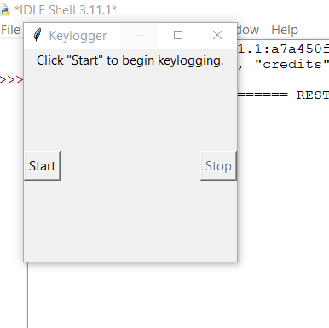
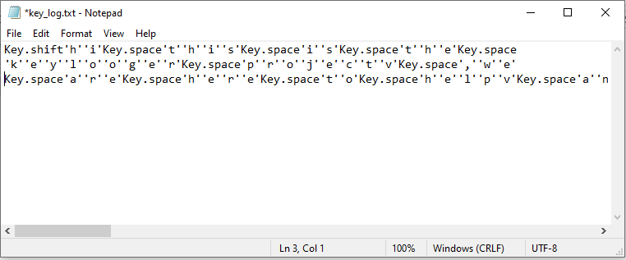
RESULT OUTPUT

Slide 12
Project Git Hub Link
https://github.com/jagadee-45/Keylogger.git

